Slide 1

Dr. AMBEDKAR INSTITUTE OF TECHNOLOGY (An Autonomous Institute Affiliated to Vishveshvaraya Technological University, Belagavi, Accredited by NAAC, with ‘A’ Grade) Near Jnana Bharathi Campus, Bengaluru – 560056
DEPARTMENT OF ELECTRICAL AND ELECTRONICS ENGINEERING
Project on
Accident Detection and Alerting System Using ESP32
Subject Code:22EEM506
Presented By:
RASHMI .H
SHRUSTI R ITTIGI
SANDIPAN PAUL
TEJASWINI R
1DA22EE037
1DA22EE046
1DA22EE040
1DA22EE055
Under The Guidance of
Mukundaswamy M S
Assistant Professor,Dept Of EEE ,DR.AIT

Slide 2
CONTENTS
INTRODUCTION
LITRATURE SURVEY
PROBLEM STATEMENT & OBJECTIVES
METHODOLOGY
RESULTS & DISCUSSION
CONCLUSION
APPLICATIONS
REFERENCES

Slide 3
INTRODUCTION
At the current moment, the number of accident cases is emerging in an exceedingly rapid rate. Considering every minute, every hour and every day there is extremely high count of accident cases that occurs worldwide. Some accidents are minor while some are fatal which usually occurs in an unpredictable manner. In certain circumstances when there is any occurrence of an accident, if information is not clocked in to the nearby healthcare centres in time or if there is no access to the sudden emergency services or first aid might lead to the loss of life which is tragic. By taking into account all these issues there is an absolute necessity to develop a system which can scrutinize the condition and operate in an effective way to overcome the time lag between the occurrence of an accident and availability of medical services. The foremost purpose of this project is to develop a system using IoT technology which is effective enough to avoid the accidents by considering different aspects, also to detect and inform the relevant emergency centers and concerned people so as to rectify the situation without any further emergency. This can be accomplished with the usage of smart sensors by integrating it with ESP32 microcontroller enclosed in the vehicle. These sensors trigger at the occurrence time of accident. The GPS and external website modules are utilized for the notification purpose which determines the location of the accident spot and accordingly informs the nearby hospitals and concerned family members.

Slide 4
LITRATURE SURVEY
SL NO. | NAME OF THE AUTHOUR | PAPER PUBLISHED | OUTCOME
01 | Shivani Sharma, Shoney Sebastian | International Journal of Electrical and Computer Engineering (IJECE), October 2019, Volume 9, Issue 5. | This paper explains about the system which uses IoT frame work integrated along with the smart sensors and a microcontroller which are pre-programmed into the vehicle that can be activated at the time of an accident. This device is designed in such a manner that it alerts the respective authorities about an accident only if the passengers have been seriously injured.

Slide 5
SL NO | NAME OF THE AUTHOUR | PAPER PUBLISHED | OUTCOME
02 03 | Kishwer Abdul Khaliq, Amir Qayyum, Jurgen Pannek Sreenithy Chandran, Sneha Chandrasekar, Edna Elizabeth N | 2017 11th International Conference on Software, Knowledge, Information Management and Applications (SKIMA) 2016 IEEE Annual India Conference (INDICON), Pages 1-4. | In this work, a prototype is designed for the auto-detection of number of accidents on the road with the help of VANET (Vehicle Ad-hoc Network) methodology and Internet of Things. The VANET app will be able to review the intensity of the accident and the severity of an emergency with the help of mechanical and medical sensing devices. The paper mainly explain about the implementation of IoT based smart helmet called ‘Konnect’ to detect and report the accidents. This system mainly depends on the cellular devices data of the drivers and is mainly developed to ensure the higher safety for motorists. The system is built with the sensors, Wi-Fi enabled processor and cloud computing infrastructures. The processor monitors the erratic variations continuously by communicating with the accelerator values.

Slide 6
SL NO | NAME OF THE AUTHOUR | PAPER PUBLISHED | OUTCOME
04 05 | Harish Kumar N., Dr. Deepak G Pranto Karmokar, Saikot Bairagi, Anuprova Mondal, Fernaz Narin Nur, Nazmun Nessa Moon, Asif Karim, Kheng Cher Yeo | International Journal of Engineering and Techniques, November-December 2017, Volume 3, Issue 6. Proceedings of the Third International Conference on Smart Systems and Inventive Technology (ICSSIT 2020). | This paper explains about the system which detects accident swiftly and notify to the emergency centers. It examines the intelligent and fastest route for the ambulance to reach the accident detected destination by utilizing IoT technology. It also makes use of cloud storage for storing all sort of data and details of nearest hospitals and current traffic conditions. This paper discusses about the cost-effective system which is developed to auto detect accidents using IoT technology. On the account of occurrence of an accident, the data information is immediately sent to the web server and the SMS is instantly sent to the acquaintances of the victim and the concerned authorities. This system is proposed in a manner such that it can be implemented as smart accident detection and rescue system for a large vehicle populated cities.

Slide 7
PROBLEM STATEMENT
Road accidents continue to be a significant cause of fatalities and injuries worldwide. Delays in detecting and responding to accidents often exacerbate their consequences, leading to increased mortality rates and prolonged emergency response times.
Traditional accident detection systems lack real-time communication and often depend on manual intervention, which may not always be feasible in critical situations. Moreover, the absence of precise location tracking and automated alerting mechanisms poses additional challenges, especially in remote or less-frequented areas.
OBJECTIVES
To develop a reliable and efficient system for real-time accident detection.
To integrate a GPS module for accurate location tracking of accident sites.
To utilize an accelerometer for identifying abrupt changes in motion indicative of accidents.
To design a mechanism for notifying nearby individuals through an audible buzzer alert.
To establish a web-based platform for remote communication of accident details.
To enable prompt notification of emergency contacts via email or SMS alerts.
To ensure ease of deployment and adaptability for various applications, such as vehicle safety systems and personal safety devices.

Slide 8
BLOCK DIAGRAM
ESP -32
Buzzer
GPS
Power Supply
Accelerometer

Slide 9
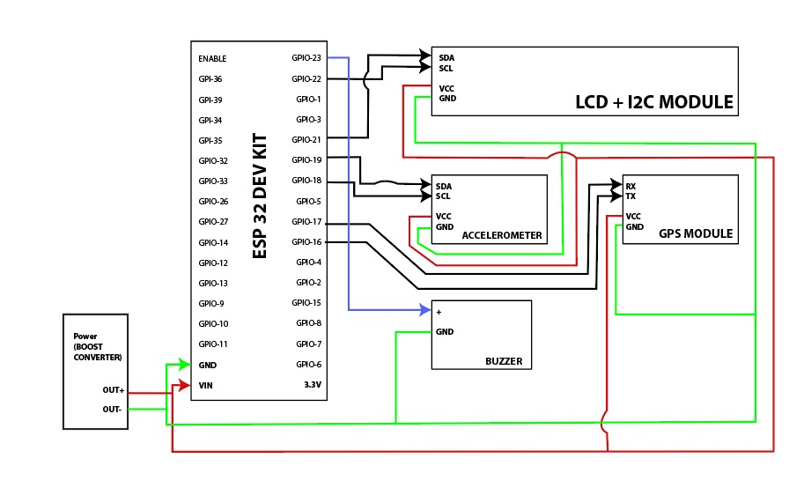
CIRCUIT DIAGRAM

Slide 10
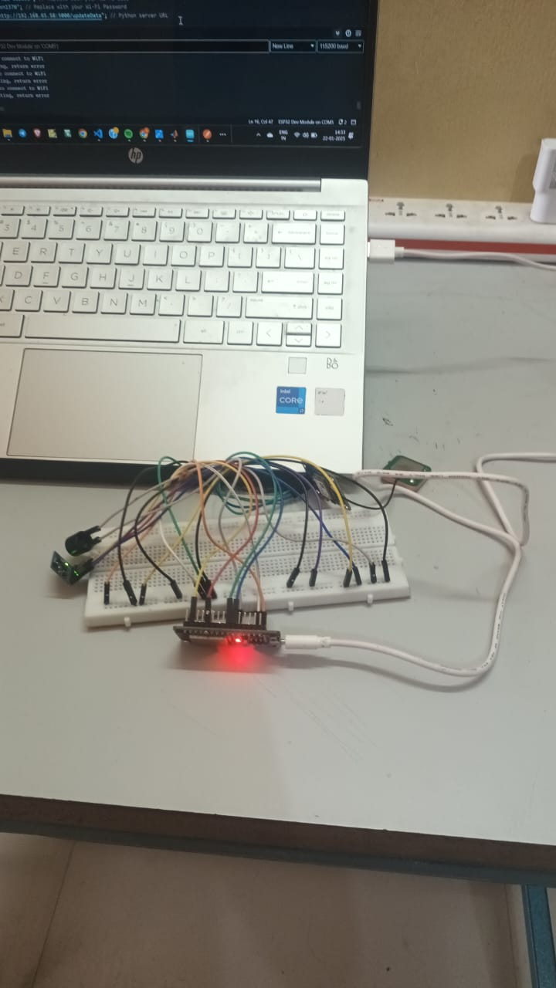

Slide 11
Methodology
The methodology for this project involves a systematic approach to design, implement, and validate the accident detection and alerting system. The process can be broken down into the following steps:
1. Requirement Analysis
Identify the key functional requirements for accident detection and alerting.
Define the hardware components: ESP32, GPS module, accelerometer, buzzer, and power supply.
Determine the software requirements, including libraries for sensor communication, GPS data parsing, and web communication.
2. Hardware Integration
ESP32 Microcontroller Setup: Configure the ESP32 as the central hub for data processing and communication.
Sensor Integration:
Connect the accelerometer to the ESP32 via I2C or SPI protocol to monitor real-time motion data.
Interface the GPS module using UART for serial communication to obtain location data.
Buzzer Connection: Attach the buzzer to a GPIO pin on the ESP32 to enable audible alerts.

Slide 12
3. Software Development
a. ESP32 Programming
Develop firmware using Arduino IDE.
Initialize sensors and modules (accelerometer, GPS, Wi-Fi).
Implement an algorithm to monitor acceleration values and detect anomalies.
Fetch GPS coordinates upon detecting an accident.
Send accident details (latitude, longitude, timestamp) to the external website via HTTP/HTTPS requests.
b. External Website Development
Build a web application to receive and process data from the ESP32.
Use a database to store accident information.
Integrate APIs to send email or SMS alerts to predefined emergency contacts.
Provide a user interface for displaying accident details and location on a map.
4. Threshold Calibration and Testing
Define thresholds for detecting accidents based on accelerometer readings (e.g., sudden deceleration).
Test the system under various scenarios, such as simulated accidents, to ensure reliability and accuracy.
Adjust thresholds and fine-tune the algorithm to minimize false positives and negatives.

Slide 13
5.Deployment
Power the system using a stable battery or USB source.
Deploy the system on a vehicle or as a portable device.
Monitor its performance in real-world conditions.
6. Validation and Feedback
Validate the system by comparing detected events with actual occurrences.
Collect feedback from users to identify areas for improvement.
Refine the hardware and software components based on real-world testing.

Slide 14
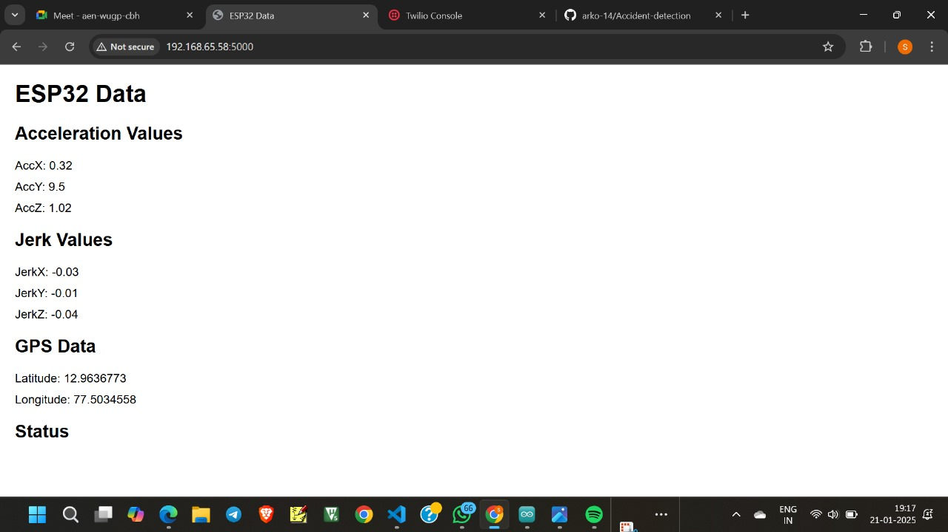
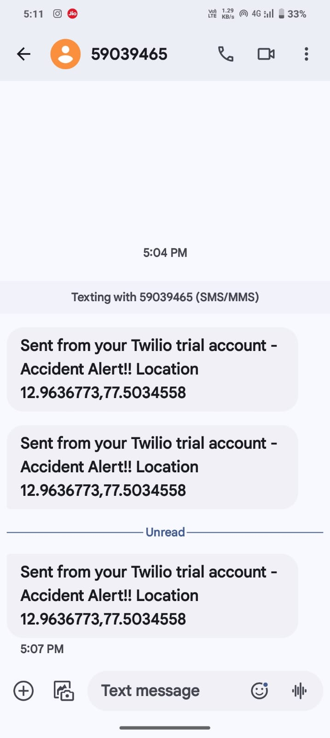
Results
The system detects abrupt changes in acceleration and identifies accidents with high accuracy.
GPS provides real-time location data with reasonable accuracy.
Alerts are sent to the external website, and predefined contacts are notified promptly.
The buzzer effectively alerts nearby individuals.

Slide 15
CONCLUSION
The accident detection and alerting system using ESP32, GPS, accelerometer, buzzer, and an external website is a reliable and cost-effective solution to address the critical issue of delayed accident detection and response. By leveraging IoT technologies and real-time communication, the system successfully integrates hardware and software components to ensure rapid detection and notification of accidents.
The system operates effectively by monitoring motion through the accelerometer, identifying abrupt changes indicative of accidents, retrieving precise location data via the GPS module, and sending alerts to emergency contacts through a web-based platform. The buzzer provides local alerts, further increasing the chances of immediate assistance.

Slide 16
Applications
Vehicle Safety Systems
Integration into cars, motorcycles, and other vehicles to automatically detect accidents and notify emergency
services or contacts . Reduces response time, potentially saving lives during critical emergencies.
2. Fleet Management
Used by fleet operators for monitoring driver safety and providing immediate alerts in case of accident.
Enhance operational efficiency and ensures timely assistance for drivers.
3.Smart Cities and IoT Networks
Acts as a node in larger smart city safety networks.
Contributes to intelligent traffic management and accident response systems.
4. Personal Safety Devices
Portable versions can be carried by cyclists, motorcyclists, or pedestrians.
Helps individuals traveling in remote areas by providing automated alerts in case of an accident.

Slide 17
REFERENCES
Arif Shaik, Natalie Bowen, Jennifer Bole, Gary Kunzi, Daniel Bruce, Ahmed Abdelgawad, Kumar Yelamarthi, “Smart Car: An IoT Based Accident Detection System”, 2018 IEEE Global Conference on Internet of Things (GCIoT).
Shivani Sharma, Shoney Sebastian, “IOT Based Car Accident Detection and Notification Algorithm for General Road Accidents”, International Journal of Electrical and Computer Engineering (IJECE), October 2019, Volume 9, Issue 5.
3. Kishwer Abdul Khaliq, Amir Qayyum, Jurgen Pannek, “Prototype of Automatic Accident Detection and Management in Vehicular Environment Using VANET and IoT”, 2017 11th International Conference on Software, Knowledge, Information Management and Applications (SKIMA).
4. Pranto Karmokar, Saikot Bairagi, Anuprova Mondal, Fernaz Narin Nur, Nazmun Nessa Moon, Asif Karim, Kheng Cher Yeo, “A Novel IOT Based Accident Detection and Rescue System”, Proceedings of the Third International Conference on Smart Systems and Inventive Technology (ICSSIT 2020).
5. Sreenithy Chandran, Sneha Chandrasekar, Edna Elizabeth N, “Konnect: An Internet of Things (IoT) based Smart Helmet for Accident Detection and Notification”, 2016 IEEE Annual India Conference (INDICON), Pages 1-4.

Slide 18
THANK YOU

